Slide 1
From Access to Learning: System effects that continue to delay children’s ability to learn.
Ania Chaluda
Education Policy and Data Center, FHI 360
achaluda@fhi360.org

Slide 2
Current trends in education in developing countries
While access to primary education has been improving…

Slide 3
Current trends in education in developing countries
…retention is still a challenge.

Slide 4
Current trends in education in developing countries
And so is learning.
Low Level of Learning in SACMEQ: Interprets meaning (by matching words and phrases, completing a sentence, or matching adjacent words) in a short and simple text by reading on or reading back.

Slide 5
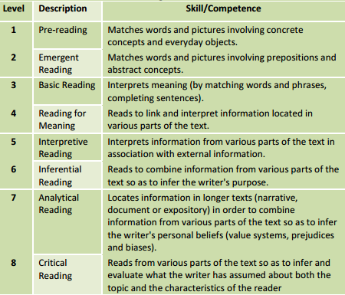
Current trends in education in developing countries

Slide 6
Current trends in education in developing countries
Low Level of Learning in SACMEQ: Interprets meaning (by matching words and phrases, completing a sentence, or matching adjacent words) in a short and simple text by reading on or reading back.
Low Level of Learning in PIRLS: Able to recognize, locate, and reproduce explicitly stated details from the texts, particularly if the details were close to the beginning of the text. Also demonstrates success with some items requiring straightforward inferences.

Slide 7
How many children are really able to read?
Let’s not forget about those children who never reached the tested grade…

Slide 8
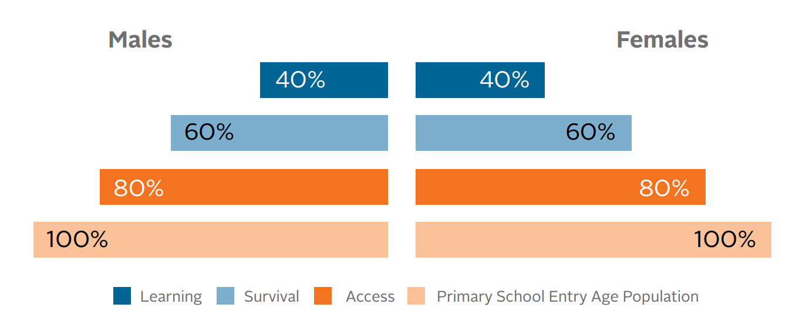
Learning Pyramid

Slide 9
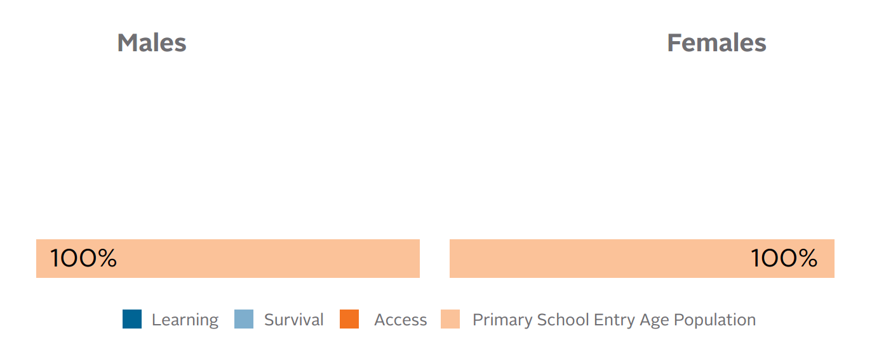
Learning Pyramid
Primary School Entry Population: usually 6 or 7 year olds

Slide 10
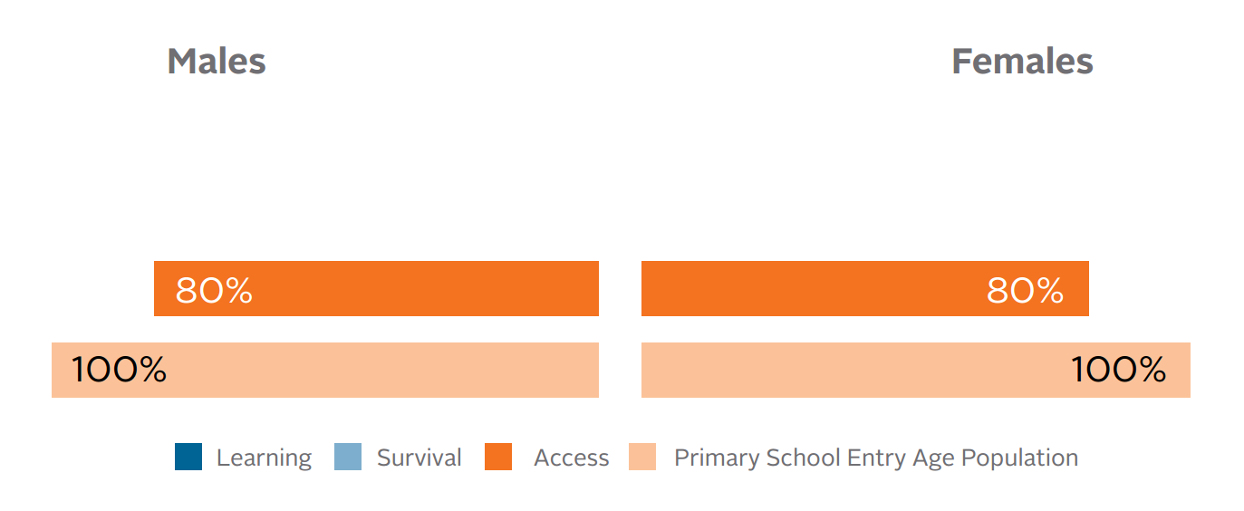
Learning Pyramid
Access: 14 year olds who have ever attended school – a generous measure of school participation

Slide 11
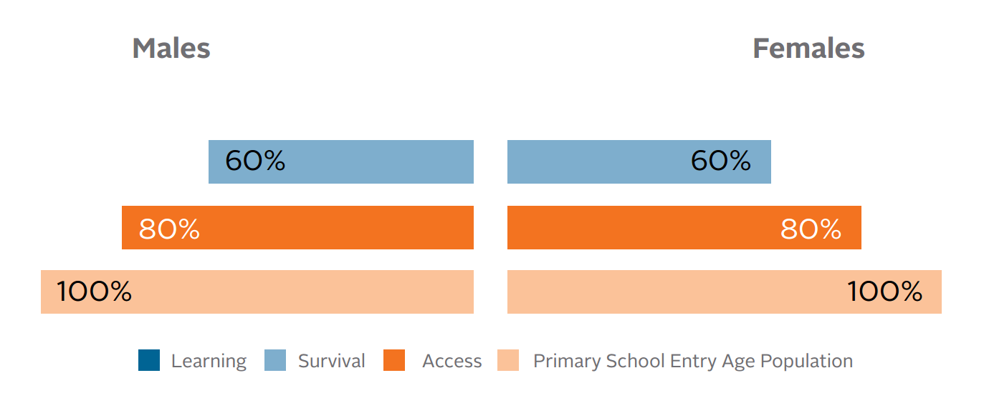
Learning Pyramid
Survival: the percentage of pupils in grade 1 who eventually reach a given grade, regardless of how many times they repeat

Slide 12
Learning Pyramid
Learning: the percentage of pupil in a given grade who have reached the low level of learning according to a given assessment test

Slide 13
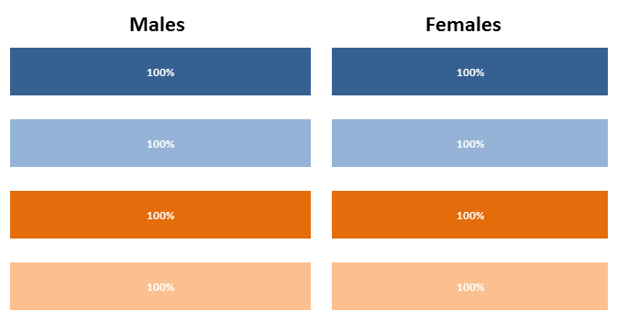
Learning Pyramid
An ideal school system:

Slide 14
Learning Pyramid – data sources
Demographic Household Surveys, Multiple Indicator Cluster Surveys
Access
Demographic Household Surveys, Multiple Indicator Cluster Surveys, UNESCO Institute for Statistics (UIS)
Survival
Learning
SACMEQ, PIRLS, SERCE and PASEC

Slide 15
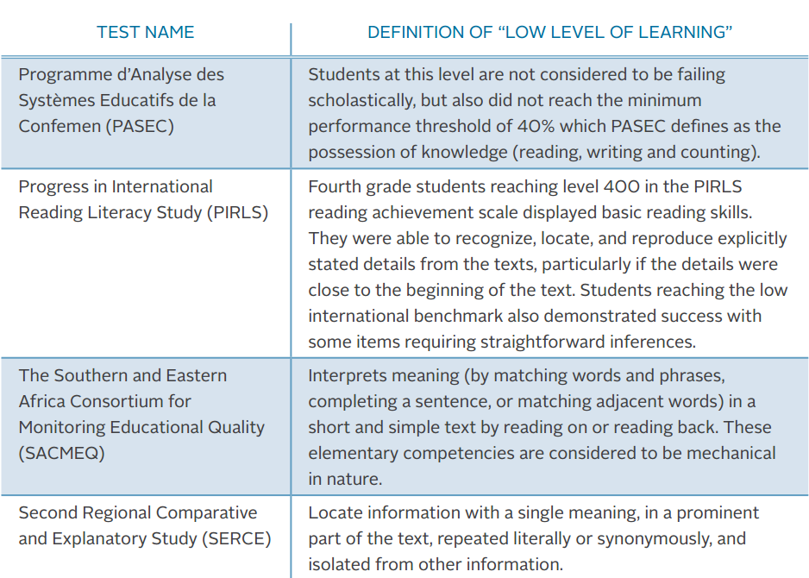
Learning Pyramid – definition of low level of learning

Slide 16
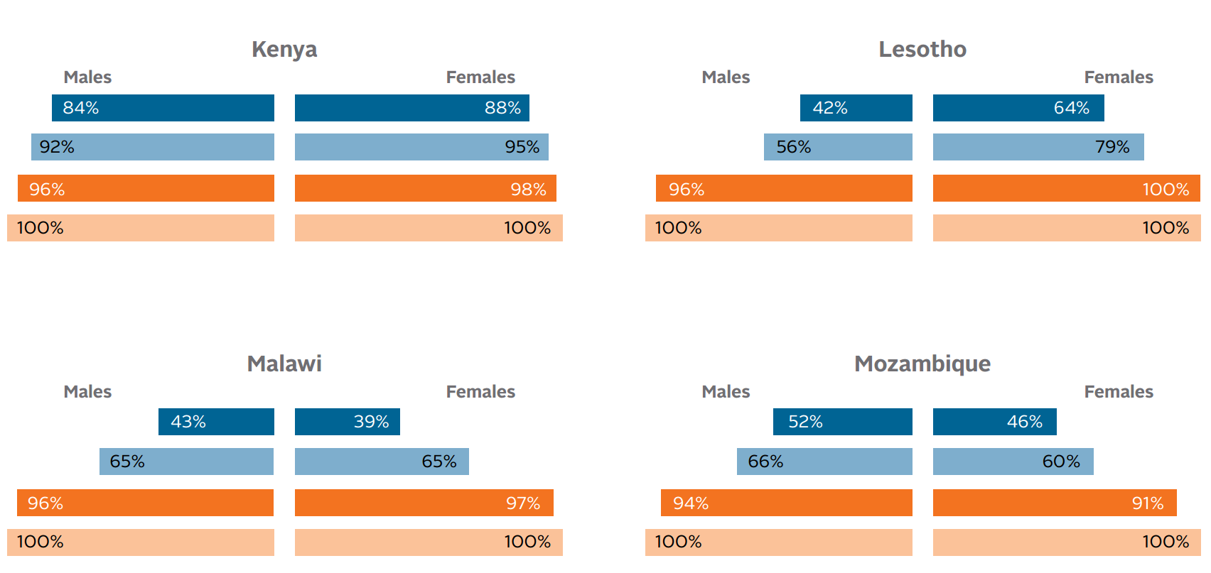
Learning Pyramid – results for Sub-Saharan Africa
Percentage of students below the low level of learning

Slide 17
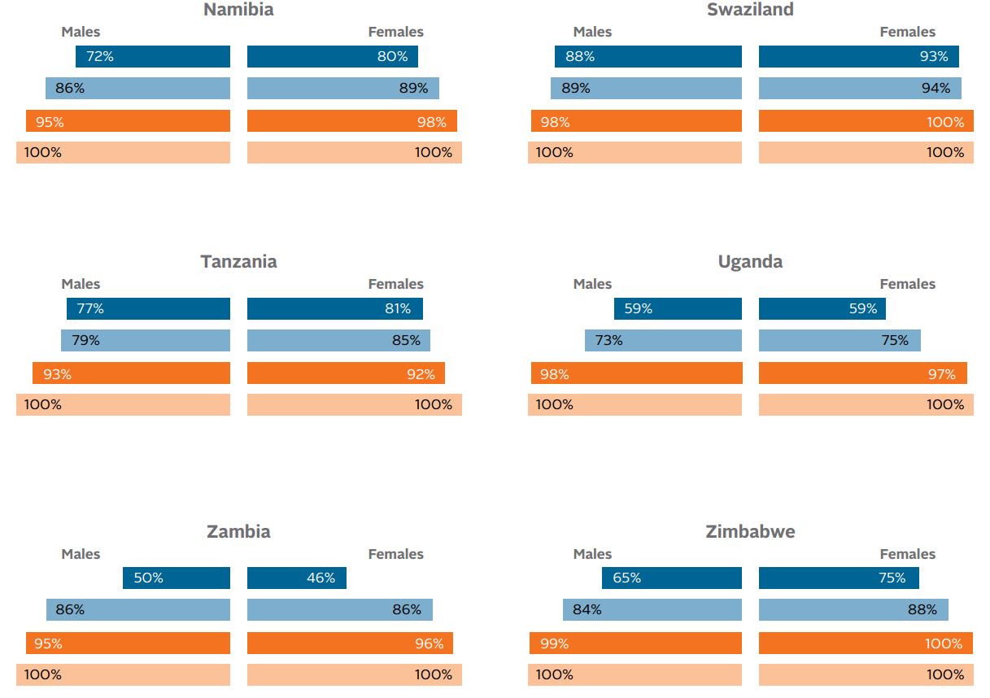
Learning Pyramid – results for Sub-Saharan Africa

Slide 18
Conclusions
While developing countries have made significant progress towards increasing enrollment levels, available student assessment data shows that in many of these countries, students don’t learn enough
The scope of the problem is emphasized when we look at other aspects of education systems, including access and retention
The current state of learning in developing countries demands focus and new creative interventions to improve instruction and increase student achievement

Slide 19
Thank you
Please visit us at www.epdc.org for more info

